Slide 1
Aadrit Chauhan
N01516539
SQL Database
HTTP:5112

Slide 2
Sanctuary Management System

Slide 3
Tables
Employees Table
Shift Table
Animal Table
Donation Table
Feeding Table
Log Table

Slide 4
Information About Tables
Employees Table
Contains information information about the employees i.e. their names and contact number.

Slide 5
Information About Tables
Shift Table
Contains information about the shift of the employees i.e. start time, end time, day of the week.

Slide 6
Information About Tables
Animal Table
This table contains information about the animals in the sanctuary i.e. animal names, animal types.

Slide 7
Information About Tables
Donation Table
This table contains information regarding the donations made towards each animal i.e. Donation amount, Animal Id.

Slide 8
Information About Tables
Feeding Table
This table contains information about the feeding time of animals in the sanctuary i.e. Animal Id, Feeding Time.

Slide 9
Information About Tables
Log Table
A table which contains the deleted data from 3 tables(Animal table, Donation table, Employees Table) through the use of 3 triggers(Trg_donation, Trg_Animal, Trg_employees). Columns are :
Log Id- primary key,
Table Name,
Table Record Id,
Delete_dateTime,
EmployeeName,
ContactNumber,
AnimalId,
DonationAmt.

Slide 10
Procedures
Created two procedures:
This procedure displays the list of employees available on a specific week day to feed the animals. The day of week will be provided by the end user.
This procedure adds a new row in the donation table if an end- user wants to make a new donation to any animal.

Slide 11
View
This view displays the total donation amounts for animals where donation amount is greater than 200.00

Slide 12
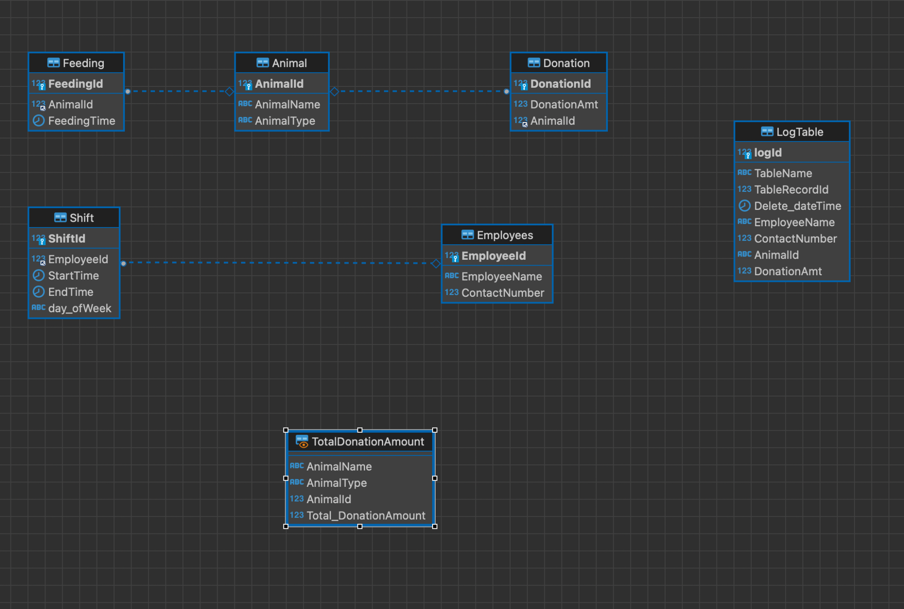
ER Diagram

